Slide 1
AI and Deep Learning
Linear Regression &
Back-propagation
Jeju National University
Yungcheol Byun

Slide 2
Agenda
Neuron and Regression
Loss/Error/Cost Function
Learning and Updating Weights
Gradient/Slope
Computation Graph
Forward Propagation
Backpropagation
Notes:
Here are what I wanna talk about: 5 parts.

Slide 3


After spending most of the ocean life, salmons go back to their home(river) where they were born.
Notes:
여러분들이 모두 알 만한 이야기가 있습니다.

Slide 4
Regression(회귀)
Go back
To describe a natural phenomena
A term frequently used in anthropology(인류학) to present a natural tendency
Notes:
common terminology

Slide 5

Regression(회귀)
Statistical measure to determine the relationship between one dependent variable (usually denoted by $Y$, 종속변수)and a series of other independent variables $X$ 독립변수 .
Notes:
Regression은 두 변수 사이의 관계를 표현하는 statistical measure

Slide 6
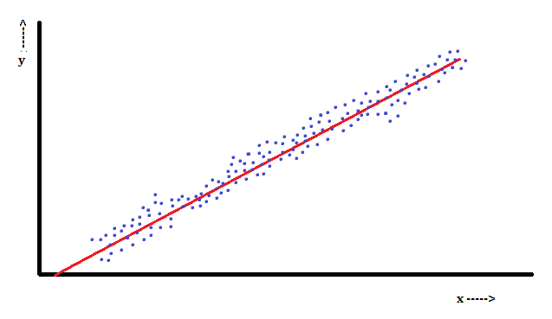
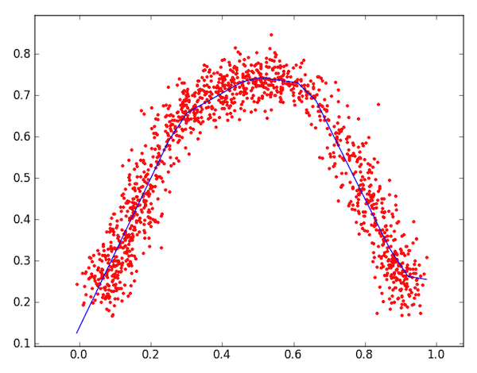
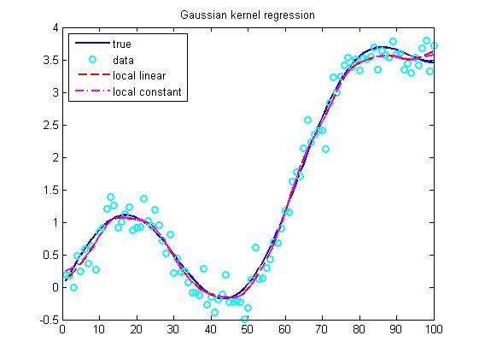
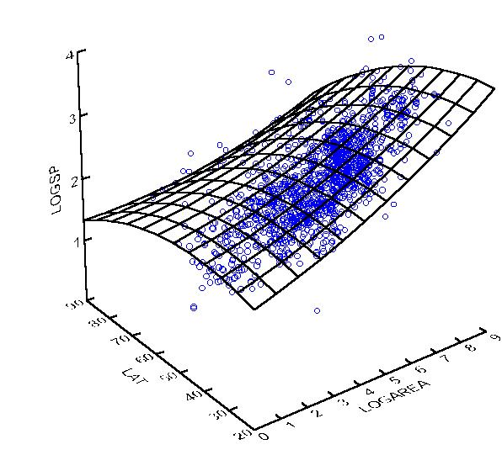
Examples of Regression
Price
Energy
Non-linear
Instances
(data)
Linear
Regression
Size of house
Age
Usage of electricity
Price
Non-linear
Non-linear
Size of house
Seasons
Size of city
Notes:
몇몇 리그레션 예제

Slide 7
Linear Regression
The relationship forms linear shape.
ex) wage/hour, price/size of house

Slide 8

Lab Linear Regression
using

Slide 9
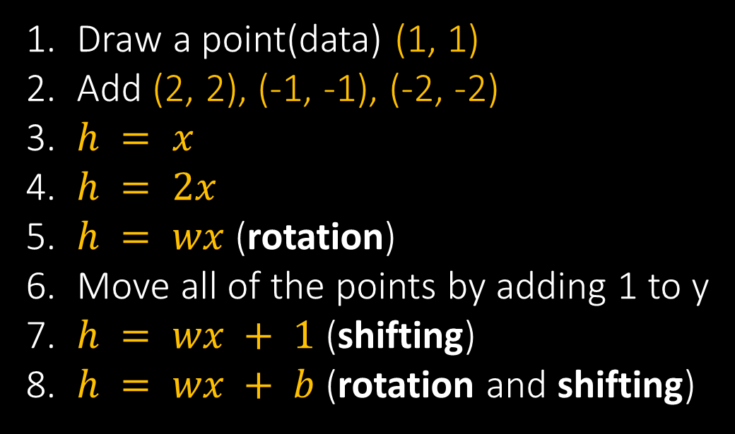
www.desmos.com
Draw a point(data) (1, 1)
Add (2, 2), (-1, -1), (-2, -2)
$h = x$
$h = 2x$
$h = wx$ (rotation)
Move all of the points by adding 1 to y
$h = wx + 1$ (shifting)
$h = wx + b$ (rotation and shifting)
Notes:
(1,1), (2,2), (3,3)
hypo = wx
err = 1/3시그마(h – x)
데이터를 하나만 남기자.
w = w + 0.01 * x * (y – h)

Slide 10
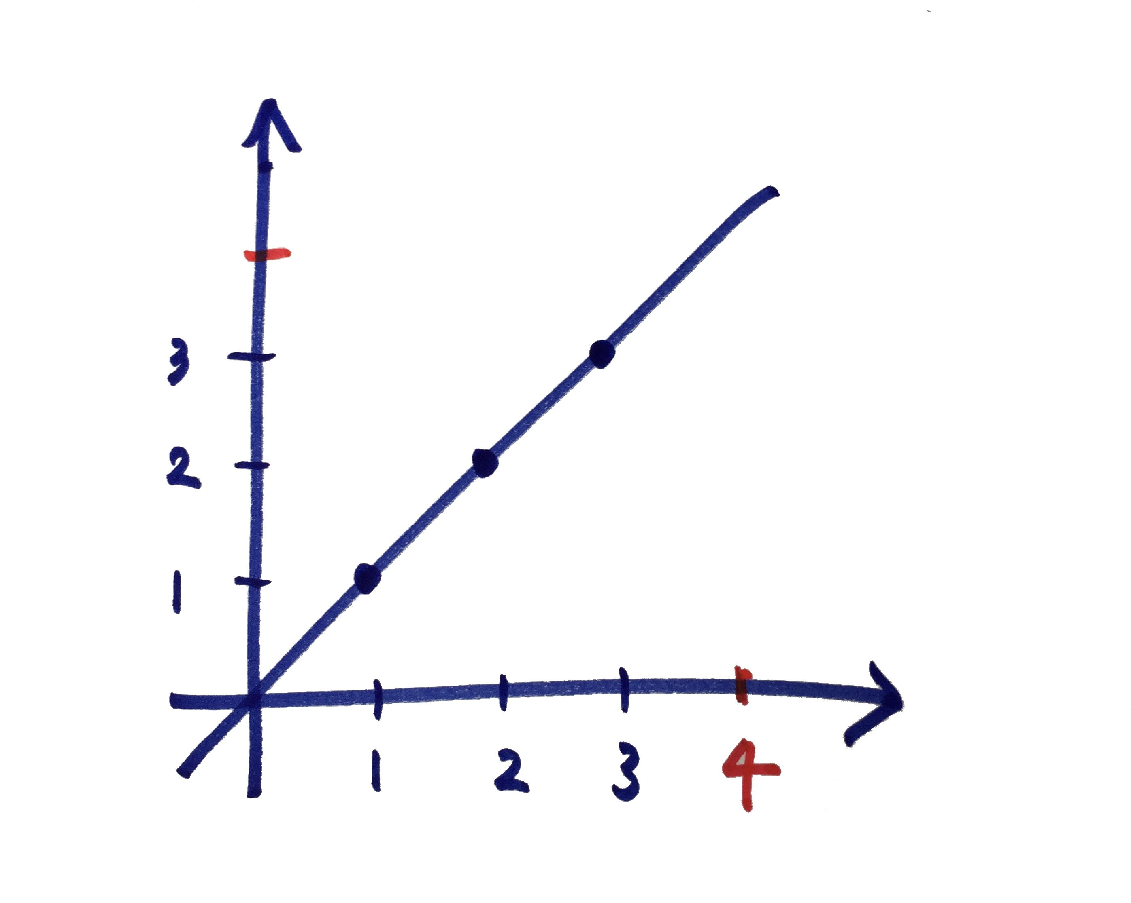
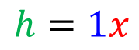


www.desmos.com
$$h$$
Wage
$$h=1x$$
$$x$$
Hour

Slide 11

$$h=wx$$

Slide 12
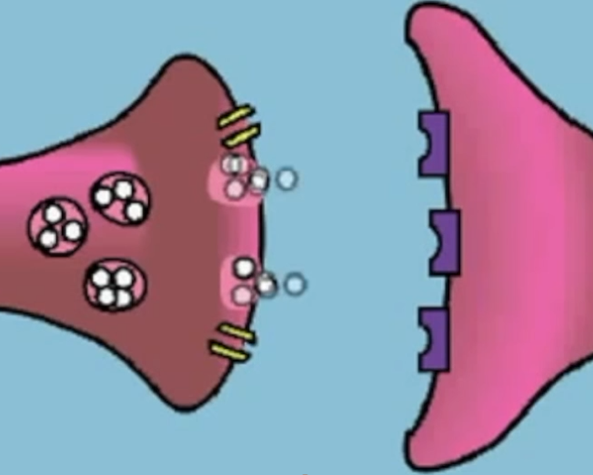


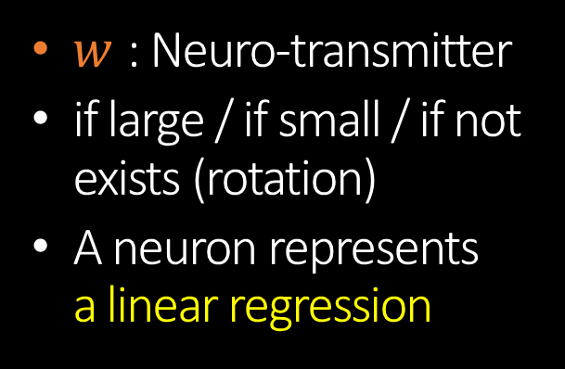

Neuron and regression
$$w$$
$$x$$
$$h=wx$$
$w$ : Neuro-transmitter
if large / if small / if not exists (rotation)
A neuron represents a linear regression

Slide 13


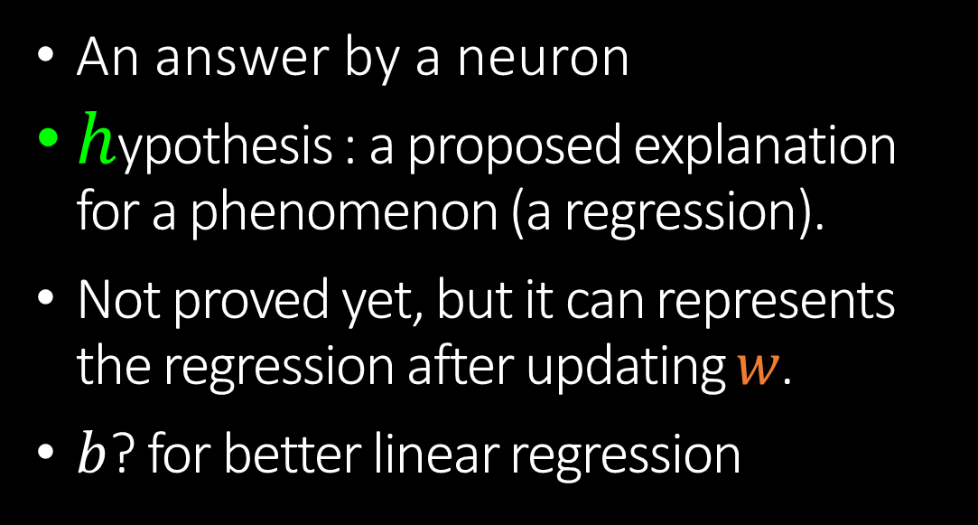

Hypothesis
$$h=wx$$
$$h=wx+b$$
An answer by a neuron
$h$ypothesis : a proposed explanation for a phenomenon (a regression).
Not proved yet, but it can represents the regression after updating $w$.
$b$? for better linear regression

Slide 14




The role of $w$ and $b$
rotation
$$w$$
Σ
$$x$$
$$h$$
hypothesis,
an output of a neuron
$$b$$
shifting
$$h=wx+b$$

Slide 15

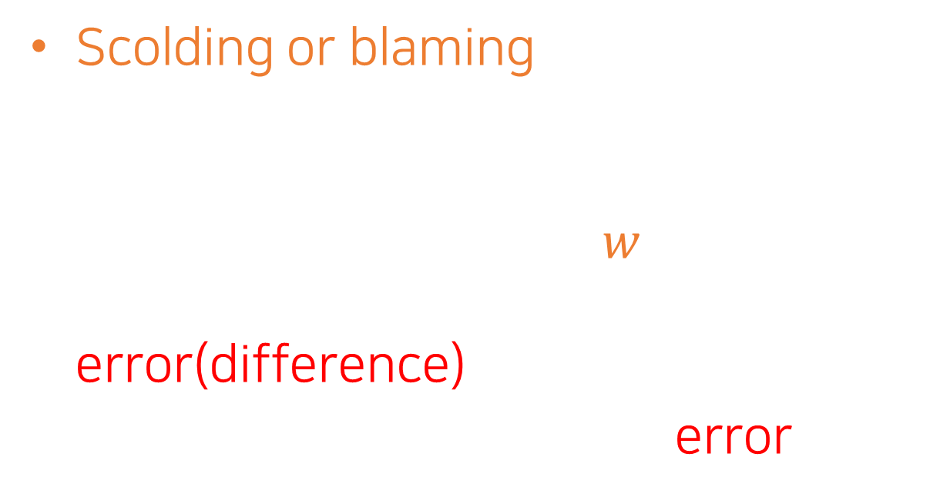
How to learn(update $w$)
Scolding or blaming the neuron if it is wrong
The neuron gets stress and automatically updates $w$ to answer well next time so that the error(difference) decreases.
How can we calculate the error?
Notes:
Yes, for this we can scold or blame the neuron when it answers incorrectly.

Slide 16

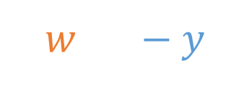




Error function
loss function
difference function
answer by a neuron
$$w$$
ground truth
$$x$$
$$h$$
$$E=$$
|$w·x−y|$
Why absolute?

Slide 17

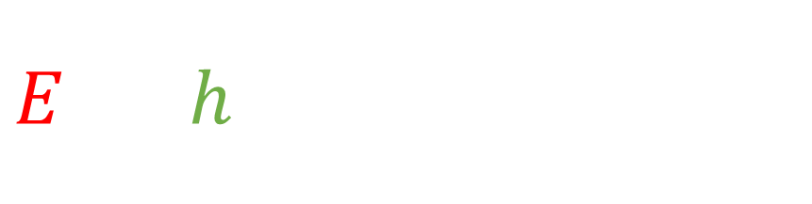
$E=$ |$h$ypothesis – $y$|
Error function
The error is the difference between a neuron’s answer and it’s ground truth.
$E=$ $|w·x −y|$

Slide 18

x_{i} | y_{i}
1 | 1
‘1 hour, then 1 USD’
$E=$ $|w·1 −1|$
Supervised Learning
지도학습

Slide 19
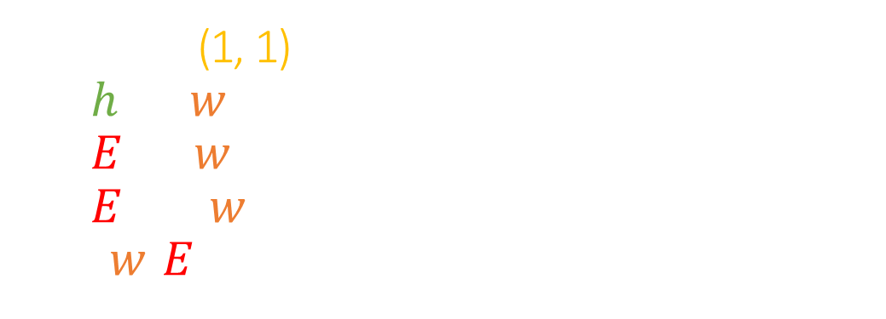
www.desmos.com
Mark (1, 1)
$h =w∙x$
$E =w∙1 −1$
$E =\left|w∙1−1\right|$
$(w, E)$
Notes:
(1,1), (2,2), (3,3)
hypo = wx
err = 1/3시그마(h – x)
데이터를 하나만 남기자.
w = w + 0.01 * x * (y – h)

Slide 20





Error Function of $w$
$$E$$
$E=$ $|w·1 −1|$
$$1$$
$$w$$

Slide 21







How to update $w$
$$E$$
Gradient decent (경사하강)
using slope
$$1$$
$$2$$
$$3$$
$$4$$
$$w$$

Slide 22

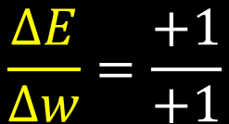







How to update $w$
learning rate (ex, 1)
$w=w− α$· Slope
$$E$$
$$4 – 1 · 1$$
$$\frac{∆E}{∆w}=\frac{+1}{+1}$$
$$∆E$$
$$∆w$$
$$4$$
$$5$$
$$w$$
Notes:
change in w
change in E

Slide 23







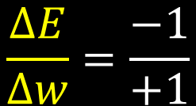


How to update $w$
learning rate (ex, 1)
$w=w− α$· Slope
$$E$$
$$− 2 – 1 · ( −1)$$
$$\frac{∆E}{∆w}=\frac{−1}{+1}$$
$$∆E$$
$$∆w$$
$$−2$$
$$−1$$
$$0$$
$$1$$
$$w$$

Slide 24






$$w=4, α=1, Slope=1$$
$w=w− α$· Slope
$4 –1·1⟶3$
$3 –1·1⟶2$
$2 –1·1⟶1$
Error $E$ = 2
Error $E$ = 1
Error $E$ = 0

Slide 25






$$w=−2, α=1,Slope=−1$$
$w=w− α$· Slope
$−2 –1·\left(−1\right)⟶−1$
$−1 –1·(−1)⟶0$
$0 –1·(−1)⟶1$
Error $E$ = 2
Error $E$ = 1
Error $E$ = 0

Slide 26






$$w=−2, α=2,Slope=−1$$
$w=w− α$· Slope
$−2 –2·\left(−1\right)⟶0$
$0 –2·(−1)⟶2$
$2 –2·(1)⟶0$
$0 –2·(−1)⟶2$
$2 –2·(1)⟶0$
Error $E$ = 1
Error $E$ = 1
Error $E$ = 1
Error $E$ = 1
Error $E$ = 1

Slide 27
Absolute Error
L1 Loss function

Slide 28
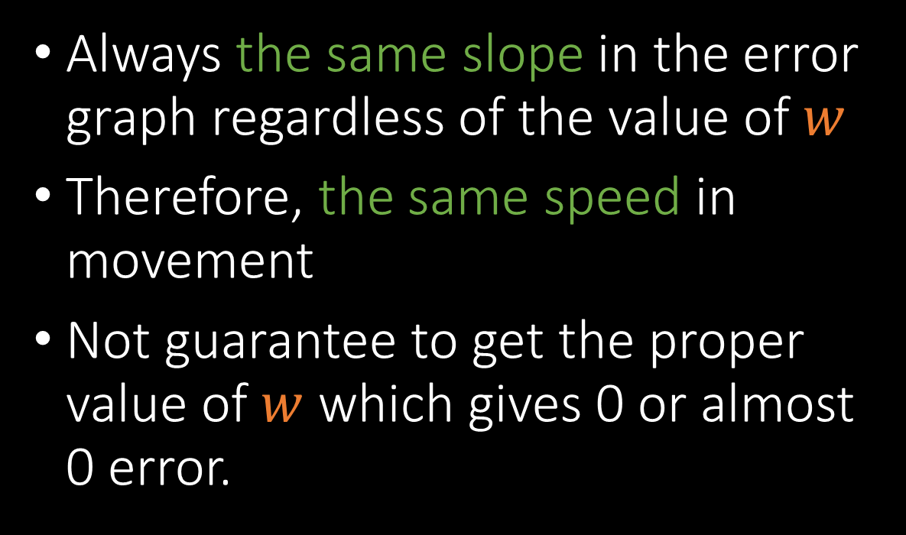
Issues in the absolute error
Always the same slope in the error graph regardless of the value of $w$
Therefore, the same speed in movement
Not guarantee to get the proper value of $w$ which gives 0 or almost 0 error.

Slide 29







Square Error
square (제곱)
error
$$( )$$
2
$$E$$
$E=$ ${|w·1 −1|}^{2}$
$$1$$
$$w$$
Notes:
마술

Slide 30



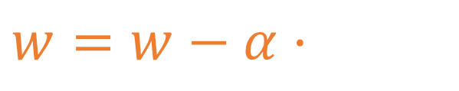
How to update $w$
$$\frac{∆E }{∆w }$$
$w=w−α·$ Slope
$$E$$
Gradient decent
$$−2$$
$$1$$
$$w$$

Slide 31


How to update $w$
$$E$$
$$−2$$
$$0$$
$$1$$
$$w$$

Slide 32
How to update $w$
$$E$$
$$−2$$
$$w$$

Slide 33



How to update $w$
slope = $\frac{∆E }{∆w }$
$$∆E$$
$$∆w$$

Slide 34


How to update $w$
slope = $\frac{∆E }{∆w }$
$$∆E$$
$$∆w$$

Slide 35

How to update $w$
slope = $\frac{∆E }{∆w }$
$$∆E$$
$$∆w$$

Slide 36

How to update $w$
slope = $\frac{∆E }{∆w }$
$$∆E$$
$$∆w$$

Slide 37


How to update $w$
slope = $\frac{∆E }{∆w }$
$$∆E$$
$$∆w$$

Slide 38


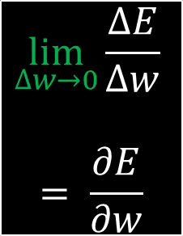
How to update $w$
접선∙Tangent line
slope = $\frac{∆E }{∆w }$
$$∆E$$
$$∆w$$
$$\lim_{∆w→0}{\frac{∆E}{∆w}}$$
$$= \frac{∂E}{∂w}$$

Slide 39
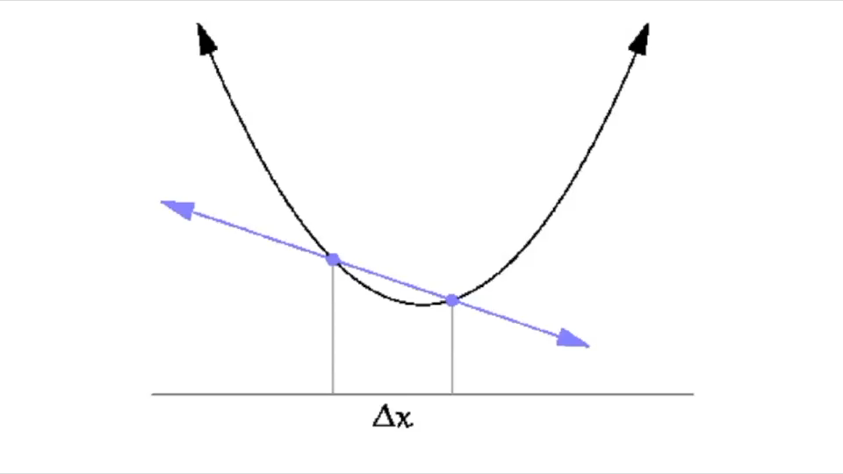

How to update $w$
$$w$$

Slide 40


How to update $w$
Numerical differentiation
① cutting into a number of minute lines (미분)
② drawing a line connection both ends of a line → a tangent line
$$\lim_{∆w→0}{\frac{∆E}{∆w}}$$
$$= \frac{∂E}{∂w}$$
$=미$분
Notes:
cut it fine

Slide 41


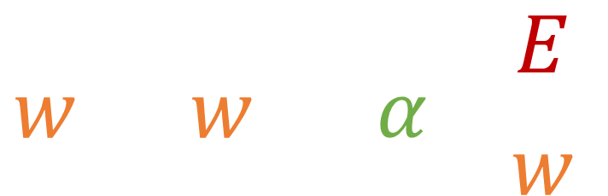
How to update $w$
$w=w− α ∗$ Slope
$$w=w− α \frac{∂E}{∂w}$$
$$α=$$
learning rate(ex, 0.1)

Slide 42
Squared Error
L2 Loss function

Slide 43
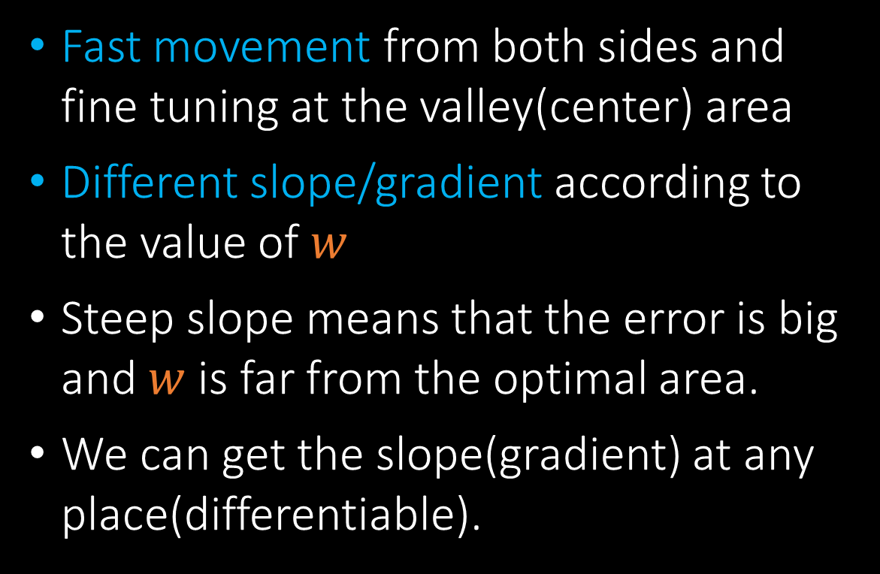
Advantages
Fast movement from both sides and fine tuning at the valley(center) area
Different slope/gradient according to the value of $w$
Steep slope means that the error is big and $w$ is far from the optimal area.
We can get the slope(gradient) at any place(differentiable).

Slide 44
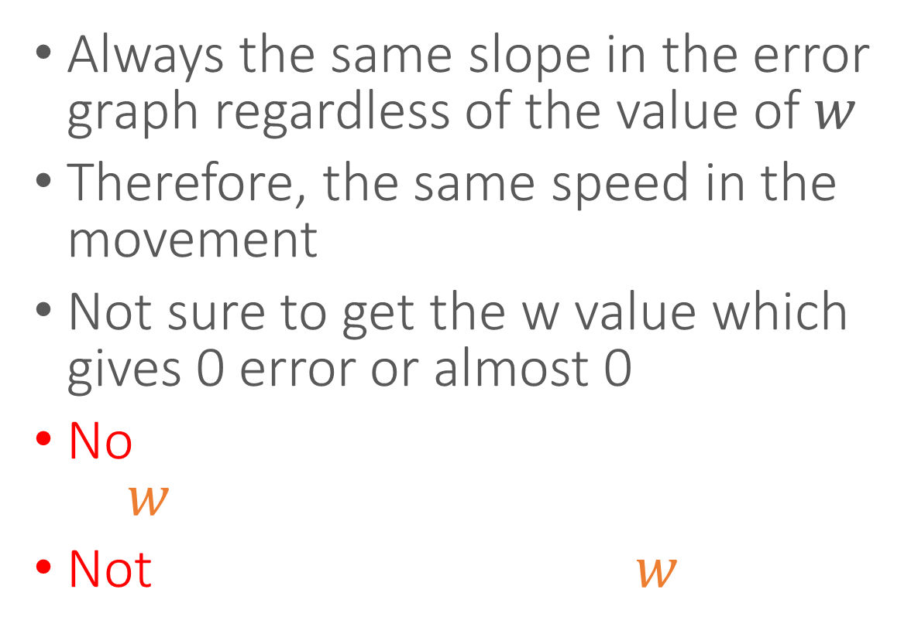
In case of AE
Always the same slope in the error graph regardless of the value of $w$
Therefore, the same speed in the movement
Not sure to get the w value which gives 0 error or almost 0
No way to guess the current value of $w$
Not differentiable when $w$ is 1

Slide 45
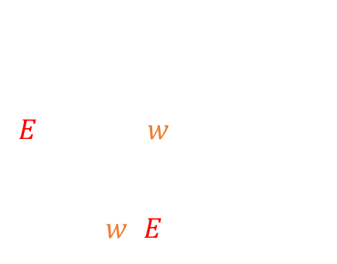
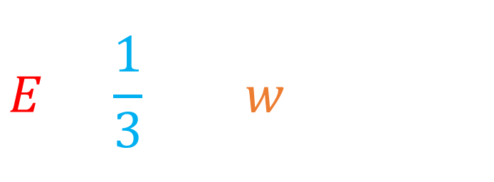
For 3 instances of data
Multiple Data
x_{i} | y_{i}
1 | 1
2 | 2
3 | 3
$$E=\frac{1}{3}\sum_{i=1}^{3}{{\left({wx}_{i}−y_{i}\right)}^{2}}$$
Add (2, 2), (3, 3)
$$E=\frac{1}{3}\sum_{i=1}^{3}{{\left({wx}_{i}−y_{i}\right)}^{2}}$$
Draw ($w$, $E$)

Slide 46
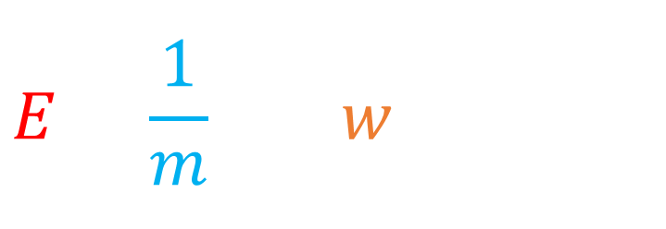

In case of $m$ instances,
Multiple Data
Mean Square
Error
An answer by a neuron
$$E=\frac{1}{m}\sum_{i=1}^{m}{{\left({wx}_{i}−y_{i}\right)}^{2}}$$
Ground truth

Slide 47
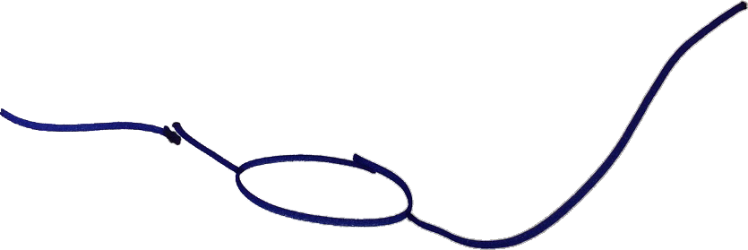
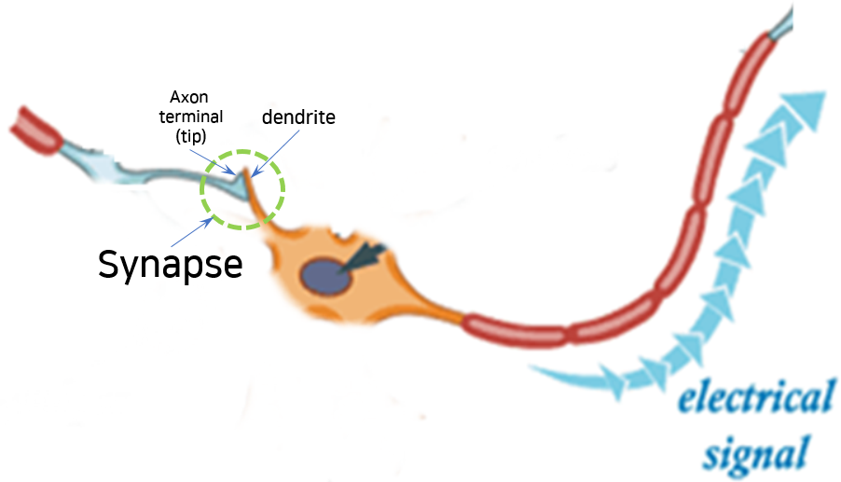
Synapse
$$w$$
$$x$$
$$h$$
$hypo$thesis
$$x$$
$$w$$
x
$hypo$thesis

Slide 48


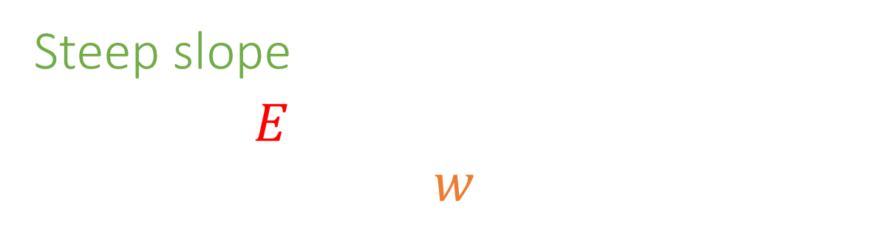



The meaning of slope
$$\frac{∆E }{∆w }$$
Steep slope
The error $E$ will change drastically when we change $w$.
$$\frac{∆E }{∆w }$$
Gentle slope
The error $E$ changes just a little bit when we change $w$.

Slide 49


Slope/Gradient
$$\lim_{∆w→0}{\frac{∆E}{∆w}} → \frac{∂E}{∂w}$$
Therefore,
means the influence of $w$ change on error $E$.

Slide 50

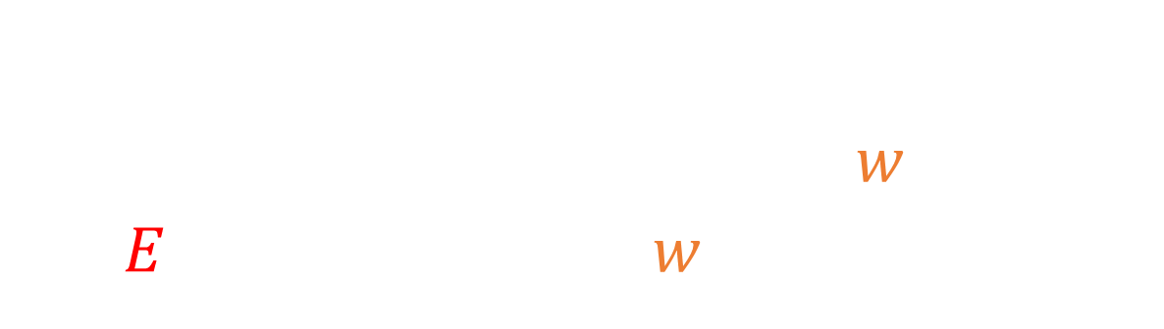
Let’s assume that data $(x, y)$ is $(1, 1)$, then compute the influence of $w$ change on $E$ when the current $w$ is equal to 3.
(Q) Compute the influence
$$E ={(wx−y)}^{2}$$

Slide 51
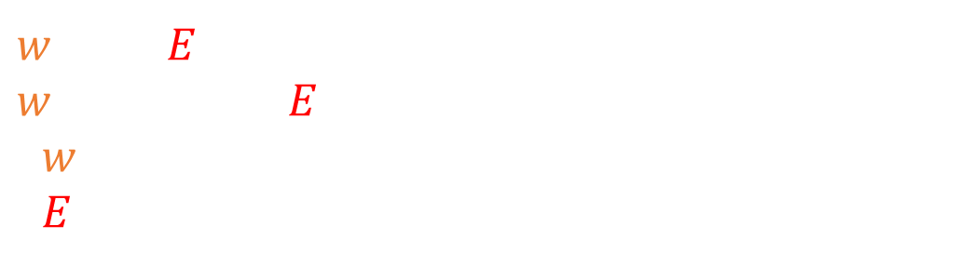

$w$: 3 -> $E$: 4 $w$: 3.00001 -> $E$: 4.00004 $∆w$=0.00001 $∆E$=0.00004
Method1
numerical gradient
$$E ={(w∙1−1)}^{2}$$
Slope =
Influence of $w$ change = 4
$$\frac{∆E}{∆w}=\frac{0.00004}{0.00001}=4$$

Slide 52


Method2
derivative, differential equation
$$E ={(w∙1−1)}^{2}$$
$$\lim_{∆w→0}{\frac{∆E}{∆w}}= \frac{∂E}{∂w}=\frac{∂}{∂w}{(w∙1−1)}^{2}$$
$$=2(w∙1−1)$$
Therefore, when $w$ = 3,
the gradient is $2(3−1) = 4$

Slide 53
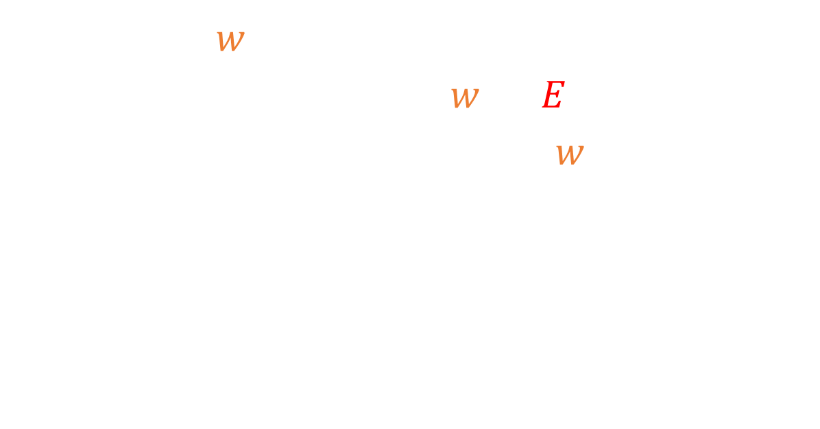

How to update $w$ (Learning)
Initialize $w$ with a random value (ex, 4)
Get influence(slope) of $w$ on $E$
To decrease the error, update $w$ using below eq:
Go to step 2
Loop
Parameter Tuning
$$W=W− α ∗slope$$

Slide 54

TensorFlow
Machine learning framework by Google
Tuning parameters including $w$ automatically instead of us
Define $w$inside of TensorFlow to be tuned (managed) by it
Hypothesis and cost_function($E$)

Slide 55
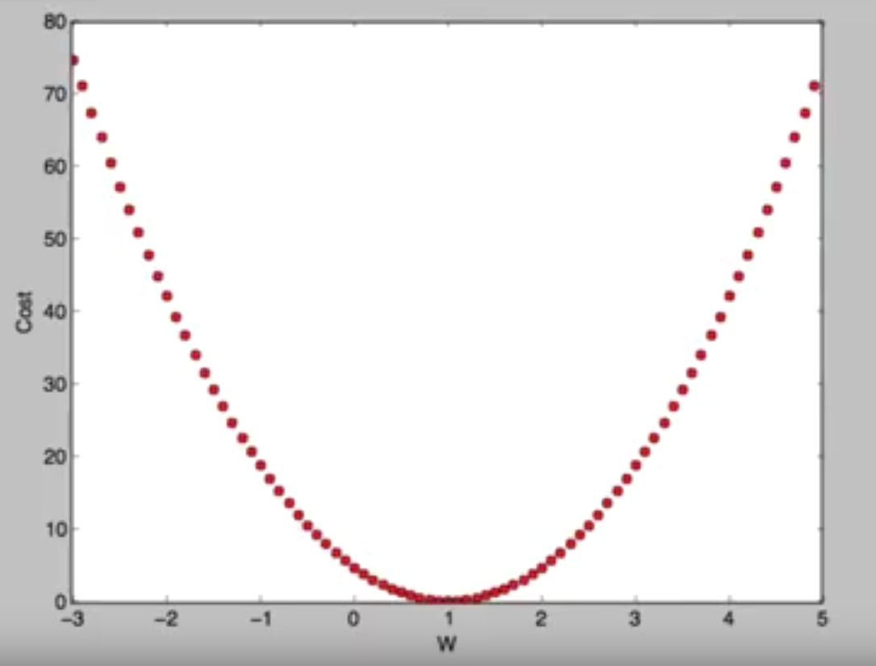
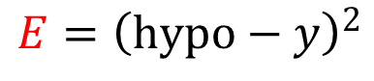
Linear Regression using TF
③
hypo=𝑤 ∗ 𝑥
④
$$h$$
w = tf.Variable(tf.random_normal([1]))
$$x$$
x
$$w$$
y = [1]
①
②
x = [1]
cost_function = (hypo – y) ** 2
⑤
$$E={\left(hypo−y\right)}^{2}$$

Slide 56
1) Run DOS prompt 2) git clone https://github.com/yungbyun/myml.git 3) Open using PyCharm (File | Open...)
Download myml.git
https://github.com/yungbyun/myml.git

Slide 57

Lab 01.py
Finding $w$ in linear regression

Slide 58
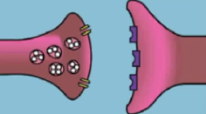
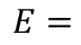
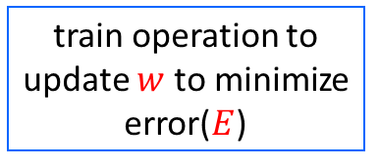
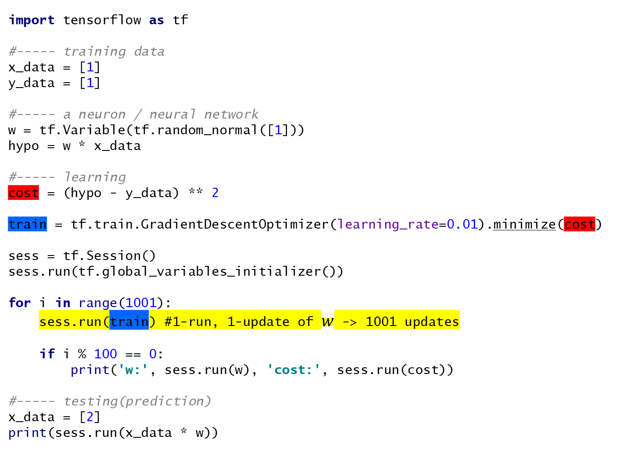
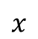
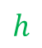

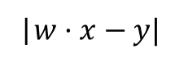
import tensorflow as tf #----- training data x_data = [1] y_data = [1] #----- a neuron / neural network w = tf.Variable(tf.random_normal([1])) hypo = w * x_data #----- learning cost = (hypo - y_data) ** 2 train = tf.train.GradientDescentOptimizer(learning_rate=0.01).minimize(cost) sess = tf.Session() sess.run(tf.global_variables_initializer()) for i in range(1001): sess.run(train) #1-run, 1-update of $w$ -> 1001 updates if i % 100 == 0: print('w:', sess.run(w), 'cost:', sess.run(cost)) #----- testing(prediction) x_data = [2] print(sess.run(x_data * w))
$$E=$$
|$w·x−y|$
$$w$$
$$x$$
$$h$$
train operation to update $w$ to minimize error($E$)

Slide 59

How to update $w$ in TensorFlow
sess.run(train)
Computation Graph

Slide 60
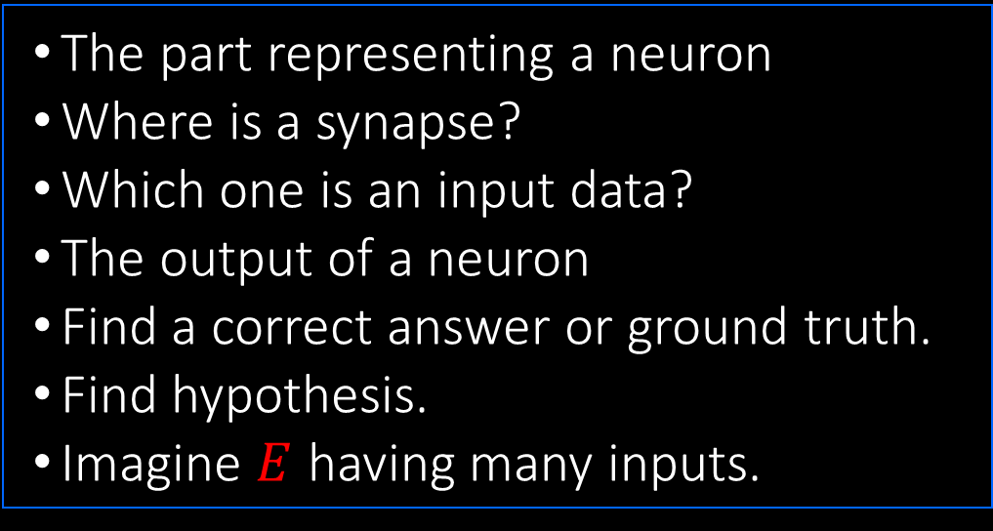

Loss/error function
$$E ={(wx−y)}^{2}$$
The part representing a neuron
Where is a synapse?
Which one is an input data?
The output of a neuron
Find a correct answer or ground truth.
Find hypothesis.
Imagine $E$ having many inputs.

Slide 61

Computation Graph
$$E ={(w∙x−y)}^{2}$$
hypo = w * x cost_function($E$) = (hypo - y) ** 2)
$$x$$
cost_function
$$h$$
$$e$$
$$E$$
×
-
$$⬚^{2}$$
$$w$$
$$y$$

Slide 62
Computation Graph
$$x$$
$$h$$
$$e$$
$$E$$
×
-
$$⬚^{2}$$
$$w$$
$$y$$
A neuron

Slide 63

Computation Graph
Data $(x, y) −> (1, 1)$
$$1$$
$$x$$
$$h$$
$$e$$
$$E$$
×
-
$$⬚^{2}$$
$$w$$
$$y$$
$$1$$

Slide 64



Computation Graph
$$\frac{∂h}{∂x}$$
$$1$$
influence of x change on h
$$x$$
$$h$$
$$e$$
$$E$$
×
-
$$⬚^{2}$$
$$w$$
$$y$$
$$1$$

Slide 65

Computation Graph
$$\frac{∂h}{∂x}$$
$$1$$
influence of x change on h
$$x$$
$$w$$
$$h$$
$$e$$
$$E$$
×
-
$$⬚^{2}$$
$$w$$
$$y$$
$$1$$

Slide 66
Local gradient

Slide 67


Computation Graph
$$1$$
$$x$$
$$w$$
$$h$$
$$e$$
$$E$$
×
-
$$⬚^{2}$$
$$w$$
$$y$$
influence of $w$ on h
$$1$$
$$\frac{∂h}{∂w}$$

Slide 68
Computation Graph
$$1$$
$$x$$
$$w$$
$$h$$
$$e$$
$$E$$
×
-
$$⬚^{2}$$
$$x$$
$$w$$
$$y$$
influence of $w$ on h
$$1$$
$$\frac{∂h}{∂w}$$

Slide 69



Computation Graph
$$\frac{∂e}{∂h}$$
$$1$$
influence of $h$ change on e
$$x$$
$$w$$
$$h$$
$$e$$
$$E$$
×
-
$$⬚^{2}$$
$$x$$
$$w$$
$$y$$
$$1$$

Slide 70
Computation Graph
$$\frac{∂e}{∂h}$$
$$1$$
influence of $h$ change on e
$$x$$
$$w$$
$$h$$
$$e$$
$$E$$
×
$$1$$
-
$$⬚^{2}$$
$$x$$
$$w$$
$$y$$
$$1$$

Slide 71


Computation Graph
$$1$$
$$x$$
$$w$$
$$h$$
$$e$$
$$E$$
×
$$1$$
-
$$⬚^{2}$$
$$x$$
$$w$$
$$y$$
$$1$$
influence of $y$ change on e
$$\frac{∂e}{∂y}$$

Slide 72
Computation Graph
$$1$$
$$x$$
$$w$$
$$h$$
$$e$$
$$E$$
×
$$1$$
-
$$⬚^{2}$$
$$x$$
$$−1$$
$$w$$
$$y$$
$$1$$
influence of $y$ change on e
$$\frac{∂e}{∂y}$$

Slide 73


Computation Graph
$$1$$
$$x$$
$$w$$
$$h$$
$$e$$
$$E$$
×
$$1$$
-
$$2e$$
$$⬚^{2}$$
$$x$$
$$−1$$
$$w$$
$$y$$
influence of $e$ change on $E$
$$1$$
$$\frac{∂E}{∂e}$$

Slide 74



5 Local Gradients
in gates
$$1$$
$$x$$
$$w$$
$$h$$
$$e$$
$$E$$
×
$$1$$
-
$$2e$$
$$⬚^{2}$$
$$x$$
$$−1$$
$$w$$
$$y$$
$$1$$

Slide 75

How can we get the influence of $w$change on $E$?

Slide 76







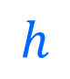










Influence between persons
$$w$$
$$x$$
$$h$$
1
$$e$$
$$2e$$
$$E$$
$$\frac{∂h}{∂w}$$
$$\frac{∂e}{∂h}$$
$$\frac{∂E}{∂e}$$
boss
head
team leader
worker
$$\frac{∂E}{∂w}=\frac{∂h}{∂w}∙\frac{∂e}{∂h}∙\frac{∂E}{∂e}=x∙1∙2e$$
$$\frac{∂E}{∂w}$$
Notes:
There are three guys

Slide 77




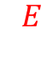


The influence of $w$change on $E$
$$\frac{∂E}{∂w}=$$
$$\frac{∂h}{∂w}$$
$$\frac{∂e}{∂h}$$
$$\frac{∂E}{∂e}$$
$$×$$
$$×$$
Chain rule!

Slide 78












$$1$$
$$x$$
$$w$$
$$h$$
$$e$$
$$E$$
×
$$1$$
-
$$2e$$
$$⬚^{2}$$
$$x$$
$$−1$$
$$w$$
$$y$$
$$1$$

Slide 79


$Composite$ Gate
$$1$$
$$x$$
$$E$$
$$x∙1∙2e$$
$$w$$
$$y$$
$$1$$

Slide 80







Forward propagation
If $(x, y)=(1, 1)$and $w= 3$, then compute $E$.
$$x$$
$$1$$
$$h$$
$$e$$
$$E$$
$$w$$
$$3$$
-
$$2$$
$$⬚^{2}$$
$$4$$
×
$$1$$
$$2e$$
$$x$$
$$−1$$
$$w$$
$$3$$
$$y$$
$$1$$

Slide 81

Error is big(4), so let’s update $w$
using back-propagation.

Slide 82
Back-propagation
$$x$$
$$1$$
$$h$$
$$e$$
$$E$$
$$w$$
$$3$$
-
$$2$$
$$⬚^{2}$$
$$4$$
×
$$1$$
$$2e$$
$$x$$
$$−1$$
$$w$$
$$3$$
$$y$$
$$1$$
Influence of e change on E

Slide 83
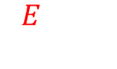
Back-propagation
$$x$$
$$1$$
$$h$$
$$e$$
$$E$$
$$w$$
$$3$$
-
$$2$$
$$⬚^{2}$$
$$4$$
×
$$1$$
$$2e$$
$$x$$
$$−1$$
$$4$$
$$w$$
$$3$$
$$y$$
$$1$$
$$\frac{∂E}{∂e}=2e$$
Influence of e change on E

Slide 84
Back-propagation
$$x$$
$$1$$
$$h$$
$$e$$
$$E$$
$$w$$
$$3$$
-
$$2$$
$$⬚^{2}$$
$$4$$
×
$$1$$
$$2e$$
$$x$$
$$−1$$
$$4$$
$$w$$
$$3$$
$$y$$
$$1$$
Influence of h on E
$\frac{∂E}{∂h}=\frac{∂e}{∂h}∙$ $\frac{∂E}{∂e}=1∙4$

Slide 85
Back-propagation
$$x$$
$$1$$
$$h$$
$$e$$
$$E$$
$$w$$
$$3$$
-
$$2$$
$$⬚^{2}$$
$$4$$
×
$$1$$
$$2e$$
$$x$$
$$4$$
$$−1$$
$$4$$
$$w$$
$$3$$
$$y$$
$$1$$
Influence of h on E

Slide 86
Back-propagation
$$x$$
$$1$$
$$h$$
$$e$$
$$E$$
$$w$$
$$3$$
-
$$2$$
$$⬚^{2}$$
$$4$$
×
$$1$$
$$2e$$
$$x$$
$$4$$
$$−1$$
$$4$$
$$w$$
$$3$$
$$y$$
$$1$$
$$\frac{∂E}{∂w}=\frac{∂h}{∂h}∙\frac{∂E}{∂h}=1∙1∙4$$
Influence of change w on E

Slide 87
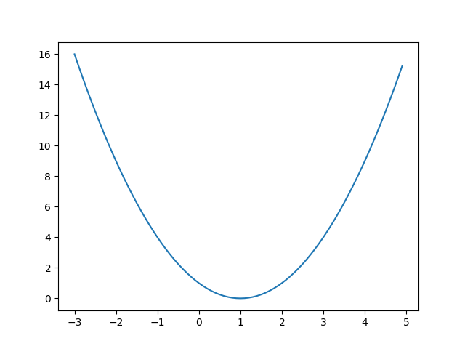
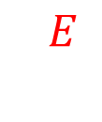
$$E ={(wx−y)}^{2}$$
$$x$$
$$1$$
$$h$$
$$e$$
$$E$$
$$w$$
$$3$$
-
$$2$$
$$⬚^{2}$$
$$4$$
×
$$1$$
$$2e$$
$$x$$
$$4$$
$$−1$$
$$4$$
$$w$$
$$3$$
$$4$$
$$y$$
$$1$$
$$\frac{∂E}{∂w}$$
Influence of change w on E
Notes:
skew, slope, derivative, the influence

Slide 88
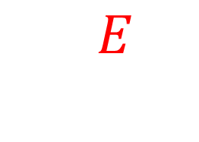
Back-propagation, the process to apply chain rules.
$$\frac{∂E}{∂w}$$

Slide 89
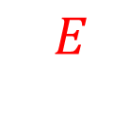

$$\frac{∂E}{∂w}$$
$w=3−0.1 ∗$ $4$
$w=$ 2.6
Tuned parameter after 1 step learning
After enough number of steps,
the parameter $w$will be optimized.

Slide 90

Backpropagation
by Paul Webros (1974, 1982) and
Geoffrey Hinton (1986)
Univ. of Toronto, Google Brain
Yann LeCun (post doc)

Slide 91
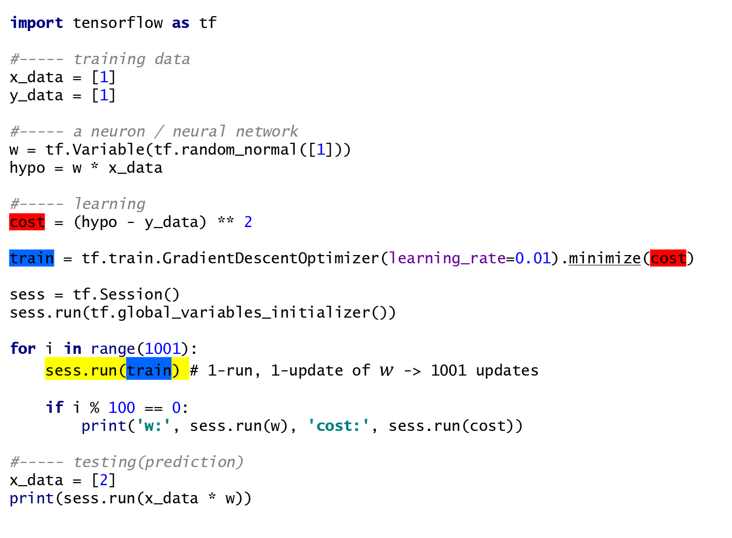
import tensorflow as tf #----- training data x_data = [1] y_data = [1] #----- a neuron / neural network w = tf.Variable(tf.random_normal([1])) hypo = w * x_data #----- learning cost = (hypo - y_data) ** 2 train = tf.train.GradientDescentOptimizer(learning_rate=0.01).minimize(cost) sess = tf.Session() sess.run(tf.global_variables_initializer()) for i in range(1001): sess.run(train) # 1-run, 1-update of $w$ -> 1001 updates if i % 100 == 0: print('w:', sess.run(w), 'cost:', sess.run(cost)) #----- testing(prediction) x_data = [2] print(sess.run(x_data * w))
train operation to update w to minimize cost(error)

Slide 92
Extension of the Graph
adding bias $b$ (one more plus gate)
a neuron with 3 inputs (2 more + gate)
two neurons

Slide 93
$$E ={((wx+b)−y)}^{2}$$
$$x$$
$$h$$
$$e$$
$$E$$
×
+
-
$$⬚^{2}$$
$$w$$
$$y$$
$$b$$

Slide 94
$$E ={((w1x1+w2x2+w3x3+b)−y)}^{2}$$
$$x1$$
×
$$w1$$
+
$$x2$$
$$h$$
$$e$$
$$E$$
×
+
+
-
$$⬚^{2}$$
$$w2$$
$$y$$
$$x3$$
$$b$$
×
$$w3$$

Slide 95

Learning, making the connection better

Slide 96


Cost(Error) graph
$$E ={(w∙1−1)}^{2}$$
$$E$$
$$w$$
$$w$$
$$E ={(w1∙1+w2∙1−1)}^{2}$$
convex function
$$E$$
$$w_{1}$$
$$w_{2}$$
$$w_{1}$$
$$w_{2}$$
convex function
Notes:
Axis of y is cost, axis of x is input (one input)
입력이 하나이면
입력이 2개이면
입력이 3개이면? 4dim. 상상불가.

Slide 97
Lab 02.with_bias.py
Parameter tuning including bias

Slide 98
Lab 03.py
Using multiple data

Slide 99
Lab 04.py
Training a neuron having multiple inputs

